Slide 1
Packet classification Hierarchical based algorithm
Algorithm implementation in Python
Algorithm performance parameters
Professor(s): Achille Pattavina and Guido Maier
Assistant: Sebastian Troia
Mohammad Ala Amjadi
Person code: 10479915
Master of telecommunication engineering
Politecnico di Milano – September 2020

Slide 2
Introduction
1
To meet various QoS requirements, routers need to implement the following features
Admission control
Resource reservation
Per-flow queueing
Fair scheduling
They need to be able to distinguish and classify the incoming traffic into different flows (flow-aware routers) which is the principle of SDN and OpenFlow
Flows are specified by rules
Each rule consist of operations comparing packet fields with certain values
A set of rules is called a classifier
Based on the criteria to be applied to classify packets with respect to a given network application
2
3
4

Slide 3
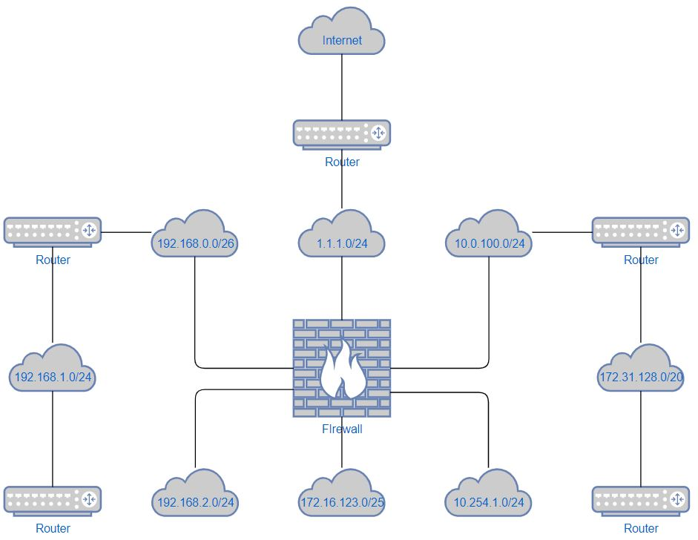
Network Diagram in general

Slide 4
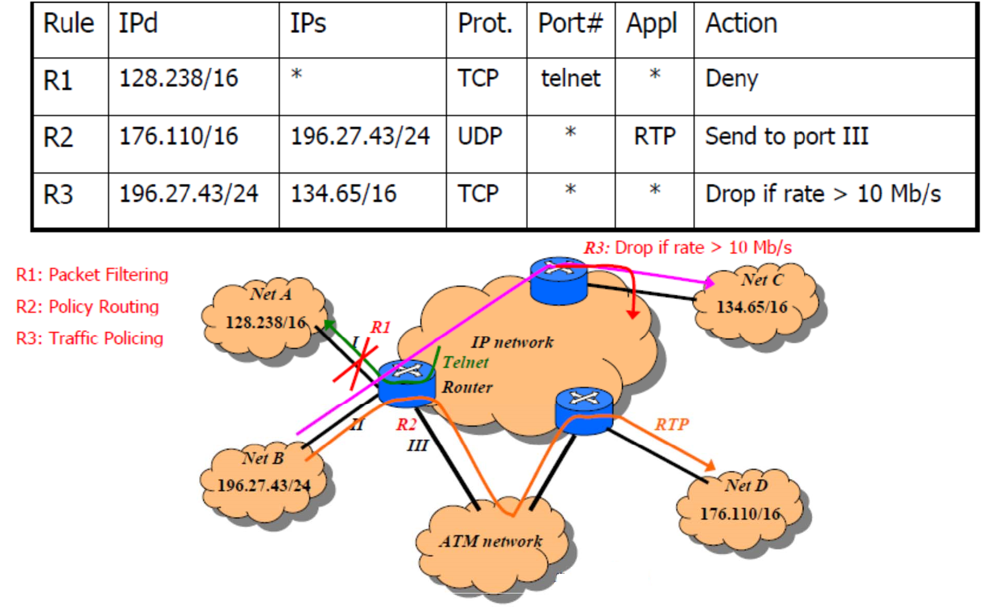
A packet classifier example

Slide 5
Classifier definition
A classifier C consists of N rules, Rj, 1 ≤ j ≤ N, where Rj is composed of three entities:
A regular expression Rj[i], 1 ≤ i ≤ d, on each of the d header fields of a packet.
A number, Pri(Rj), indicating the priority of the rule in the classifier.
An action, referred to as Action(Rj).
An incoming packet P with the header considered as a d-tuple (P1, P2, . . . , Pd) is said to match Rj , if and only if, Pi matches Rj[i], where 1 ≤ i ≤ d.
Given an incoming packet P and thus the d-tuple, the d-dimensional packet classification problem is to find the rule Rm with the highest priority among all the rules Rj matching the d-tuple
An IPv4 packet header, consists of:
Source IP 32bits
Destination IP 32bits
Protocol 8bits
Source port 16bits
Destination port 16bits
The matching rule in the classifier with the highest priority is chosen and its corresponding action is applied to the packet

Slide 6
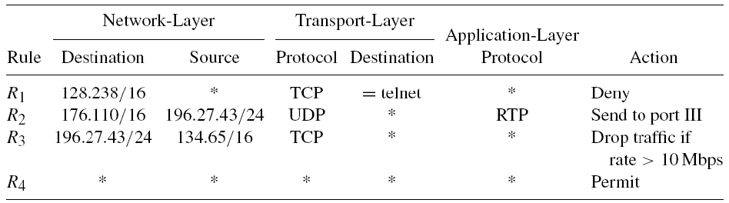
Classifier table example
Each rule has five regular expressions on five packet-header fields from network layer to application layer
Each expression could be:
Simple prefix/length specification => Same definition as in P lookups
Operator/number specification => could be more general, such as equal 23, range 256-1023, and greater than 1023
A wildcard can be inserted to match any value.
Note R4 ‘all-wildcards’ specification => matches with any incoming packet
The priorities of rules take effect when a packet matches both R4 and other rules

Slide 7

Program structure
Program
Hierarchical_algorithm.py main algorithm functions
Network_utils.py customized general functions and rules
main.py program to run the algorithm
Lists
rule_list.txt classification rule list
random_packets.txt randomly generated incoming packets list
incoming_packets.txt customized incoming packets list

Slide 8
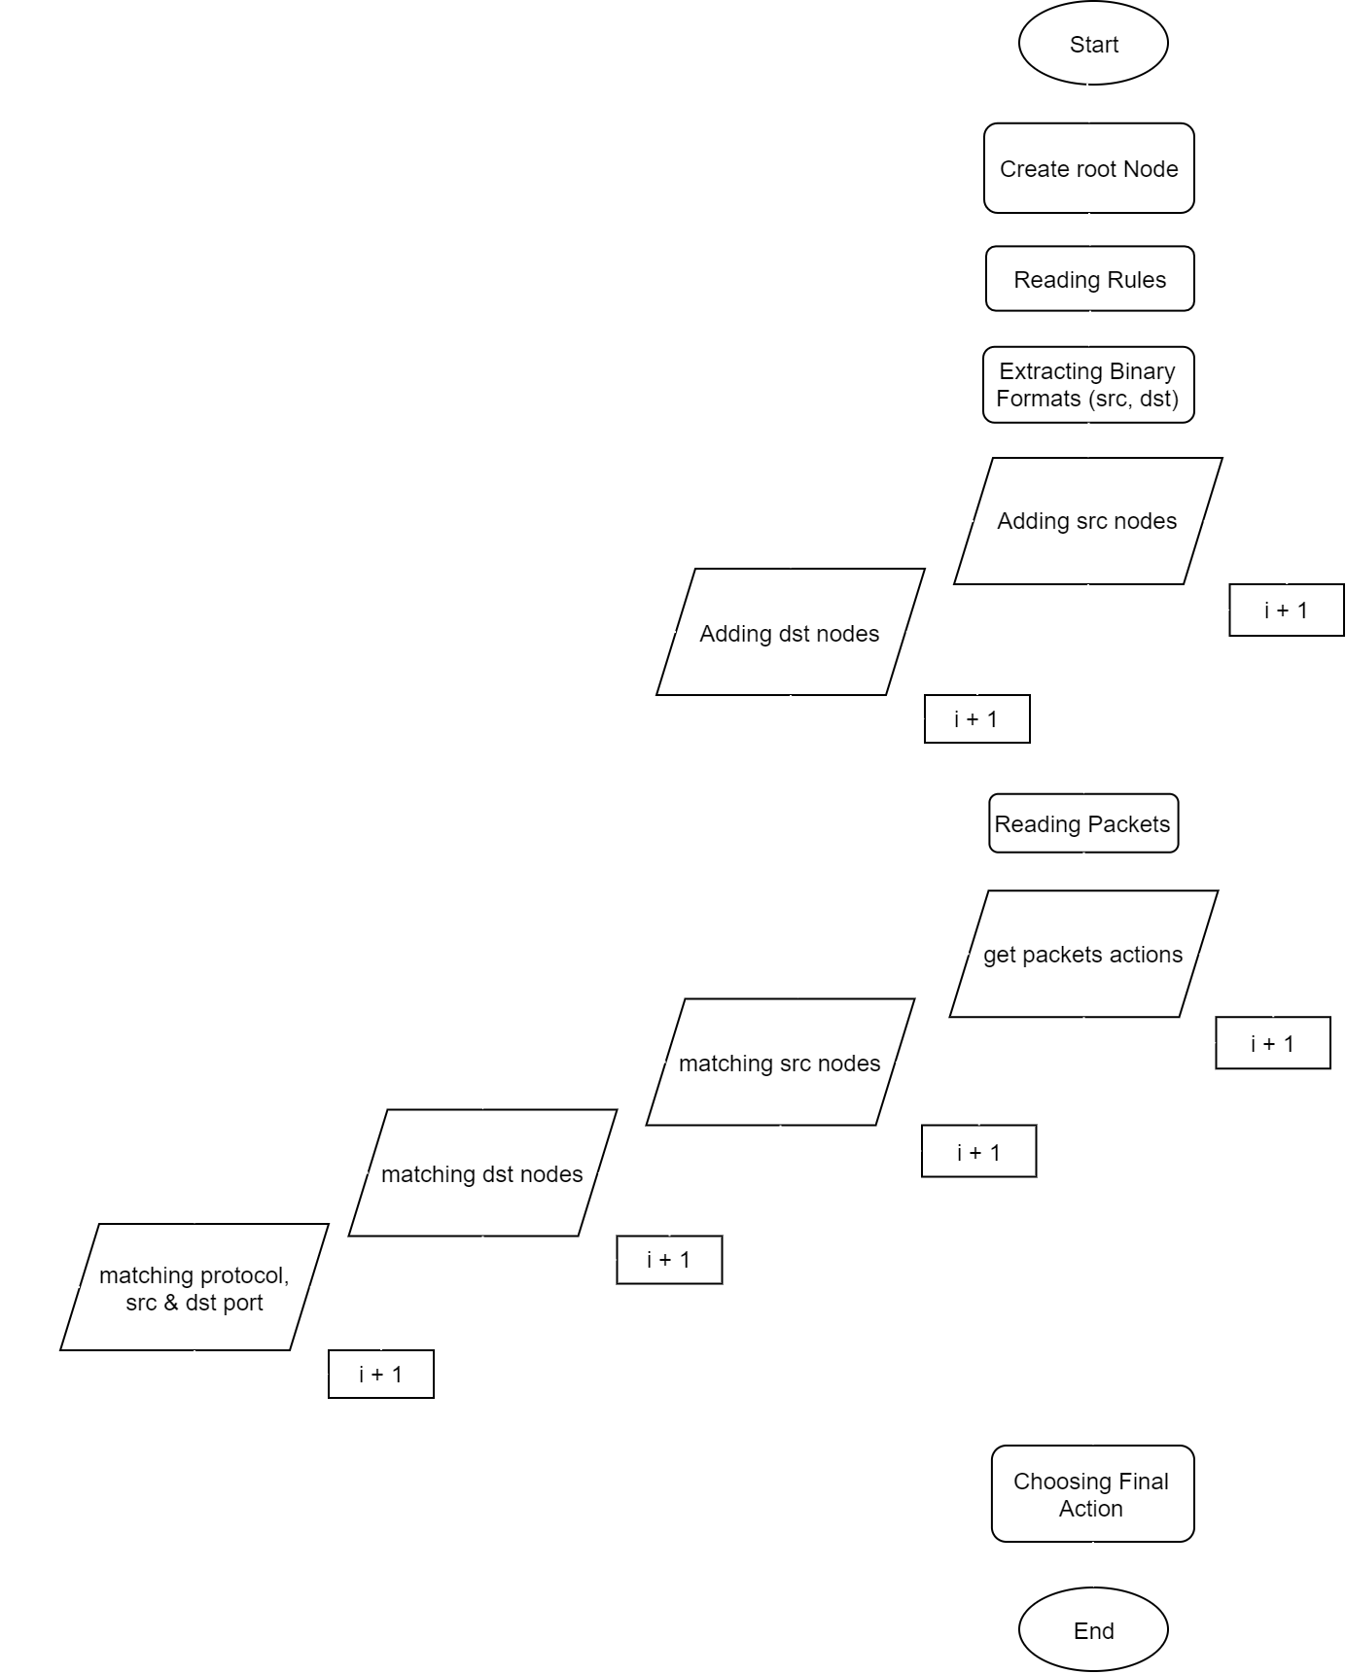
General Flow Chart of Program

Slide 9
FlowDiagram – Rule
First, we read the rule list using read_rules() function. Inside this function we go over each line of our text file (rule_list.txt) and create an object Rule. In Rule object we have all the information that we need in separate attributes. The binary format of the prefixes will be calculated using extract_info() function. If the NetID in the rule list has a * (star) value, the src_sub_binary or dst_sub_binary attribute will remain as None. All the object rules will be added to a list called all_rules.
class Rule:
src_sub = None
src_ip = None
src_netmask = None
src_sub_binary = None
dst_sub = None
dst_ip = None
dst_netmask = None
dst_sub_binary = None
src_port = None
dst_port = None
protocol = None
action = None

Slide 10
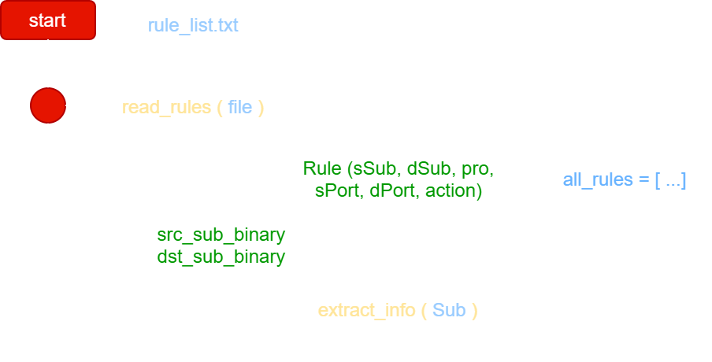
FlowDiagram – Rule
First, we read the rule list using read_rules() function. Inside this function we go over each line of our text file (rule_list.txt) and create an object Rule. In Rule object we have all the information that we need in separate attributes. The binary format of the prefixes will be calculated using extract_info() function. If the NetID in the rule list has a * (star) value, the src_sub_binary or dst_sub_binary attribute will remain as None. All the object rules will be added to a list called all_rules.
def __init__(self, src_sub, dst_sub, protocol, src_port, dst_port, action):
self.src_sub = src_sub
self.dst_sub = dst_sub
self.protocol = protocol
self.src_port = src_port
self.dst_port = dst_port
self.action = action
if self.src_sub is not '*':
self.src_ip, self.src_netmask, self.src_sub_binary = extract_info(self.src_sub)
if self.dst_sub is not '*':
self.dst_ip, self.dst_netmask, self.dst_sub_binary = extract_info(self.dst_sub)

Slide 11
FlowDiagram – Rule
First, we read the rule list using read_rules() function. Inside this function we go over each line of our text file (rule_list.txt) and create an object Rule. In Rule object we have all the information that we need in separate attributes. The binary format of the prefixes will be calculated using extract_info() function. If the NetID in the rule list has a * (star) value, the src_sub_binary or dst_sub_binary attribute will remain as None. All the object rules will be added to a list called all_rules.
Then the root Node object will be created. This has some attributes which will help us to implement the tree. Each node has a value, zero, one, dst_root, end and node_rules attribute. The value attribute is used to better understand the tree and draw it. By default the end attribute is False and if it becomes True it means we have reached the end of the tree.
value = “^” The main root node
value = “#” Second tier root node
value = “$” The last node of second tier
The dst_root will be used for the first node of second tier that becomes as a root of the new tree in the second tier. node_rules is a list of all the rules were a match for this node. one and zero attributes are obviously the binary tree arcs that we have.
class Node:
value = None
zero = None
one = None
dst_root = None
end = False
node_rules = None
def __init__(self, value="^", end=False):
self.value = value
self.end = end
if self.end:
self.node_rules = []

Slide 12
FlowDiagram – Algorithm start
src_sub_binaries and dst_sub_binaries contains only the binary values of the rules which can be extracted from all_rules list. These two new list may contain None value in case that we had * (star) as source or destination NetID.
src_sub_binaries = [x.src_sub_binary for x in all_rules]
dst_sub_binaries = [x.dst_sub_binary for x in all_rules]
By iterating over these two new lists we can start our algorithm by calling the add_src_nodes() function. This function receives a node as reference and two src_sub_binaries and dst_sub_binaries lists, and it has two indexes. The index is used for tracking the number of bits that we have covered so far. The rule_index is used in the iterations as the priority number of the rule in the all_rules list.
for i in range(0, len(src_sub_binaries)):
bt.add_src_nodes(root, src_sub_binaries[i], 0, dst_sub_binaries[i],i)

Slide 13
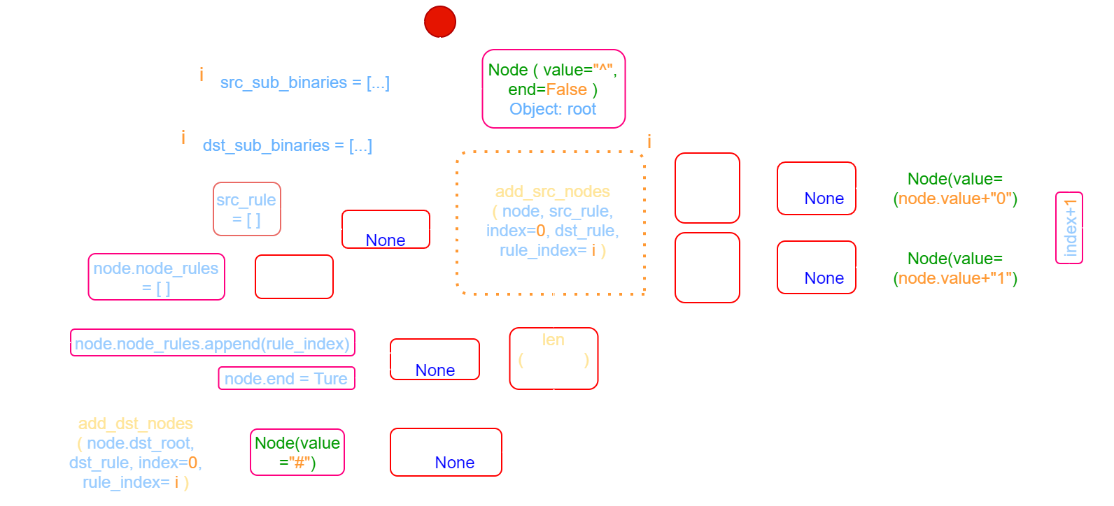
FlowDiagram – add_src_nodes()
def add_src_nodes(node, src_rule, index, dst_rule, rule_index):
if src_rule is None:
src_rule=[]
if len(src_rule) <= index :
if dst_rule is None:
if not node.end:
node.node_rules = []
node.end = True
node.node_rules.append(rule_index)
return
if node.dst_root is None:
node.dst_root = Node(value="#")
add_dst_nodes(node.dst_root, dst_rule, 0, rule_index)
return
if src_rule[index] == "0":
if node.zero is None:
node.zero = Node(value=(node.value + "0"))
add_src_nodes(node.zero,src_rule, index+1, dst_rule, rule_index)
else :
if node.one is None:
node.one = Node(value=(node.value + "1"))
add_src_nodes(node.one,src_rule, index+1, dst_rule, rule_index)

Slide 14
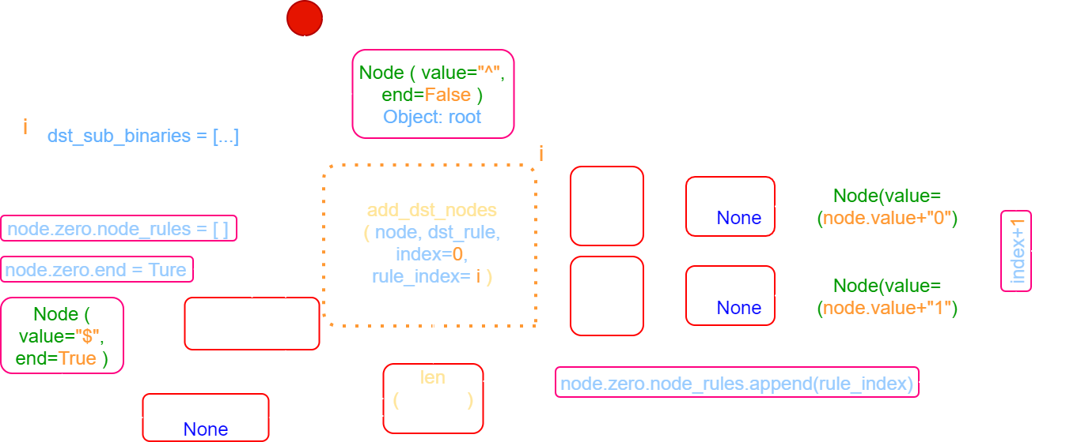
FlowDiagram – add_dst_nodes()
def add_dst_nodes(node, dst_rule, index, rule_index):
if len(dst_rule) <= index :
if node.zero is None:
node.zero = Node("$",end=True)
if not node.zero.end :
node.zero.end = True
node.zero.node_rules = []
node.zero.node_rules.append(rule_index)
return
if dst_rule[index] == "0":
if node.zero is None:
node.zero = Node(value=(node.value + "0"))
add_dst_nodes(node.zero,dst_rule, index+1, rule_index)
else :
if node.one is None:
node.one = Node(value=(node.value + "1"))
add_dst_nodes(node.one,dst_rule, index+1, rule_index)

Slide 15
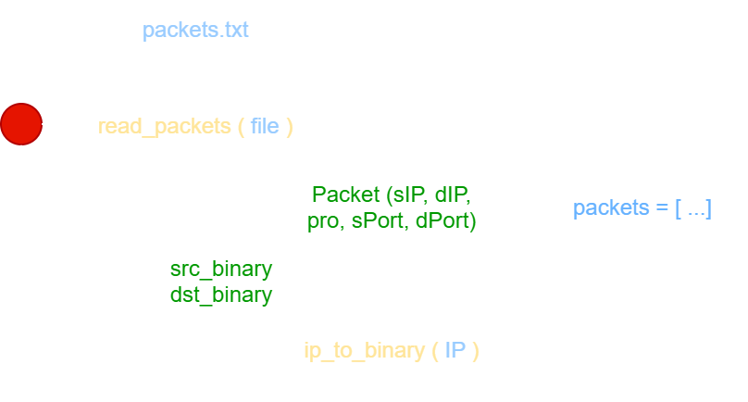
FlowDiagram – Packet Read
Then, we read the packet list using read_packets() function. Inside this function we go over each line of our text file (packets.txt) and create an object Packet. In Packet object we have all the information that we need in separate attributes. The binary format of the IP addresses will be calculated using ip_to_binary() function. All the object packets will be added to a list called packets.
class Packet:
src_ip = None
dst_ip = None
protocol = None
src_port = None
dst_port = None
src_binary = None
dst_binary = None
def __init__(self, src_ip, dst_ip, protocol, src_port, dst_port):
self.src_ip = src_ip
self.dst_ip = dst_ip
self.protocol = protocol
self.src_port = src_port
self.dst_port = dst_port
self.src_binary = ip_to_binary(src_ip)
self.dst_binary = ip_to_binary(dst_ip)

Slide 16
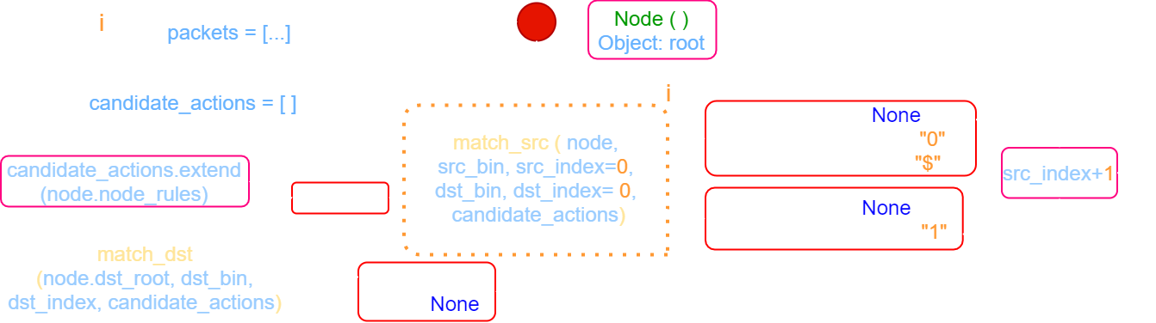
FlowDiagram – match_src()
def match_src(node, src_bin, src_index, dst_bin, dst_index, candidate_actions):
if node.end :
candidate_actions.extend(node.node_rules)
if node.dst_root is not None:
match_dst(node.dst_root, dst_bin, dst_index, candidate_actions)
if node.zero is not None and (src_bin[src_index] == "0" or node.zero.value == "$" ):
match_src(node.zero, src_bin, src_index+1, dst_bin, dst_index, candidate_actions)
if node.one is not None and src_bin[src_index] == "1":
match_src(node.one, src_bin, src_index+1, dst_bin, dst_index, candidate_actions)
return

Slide 17
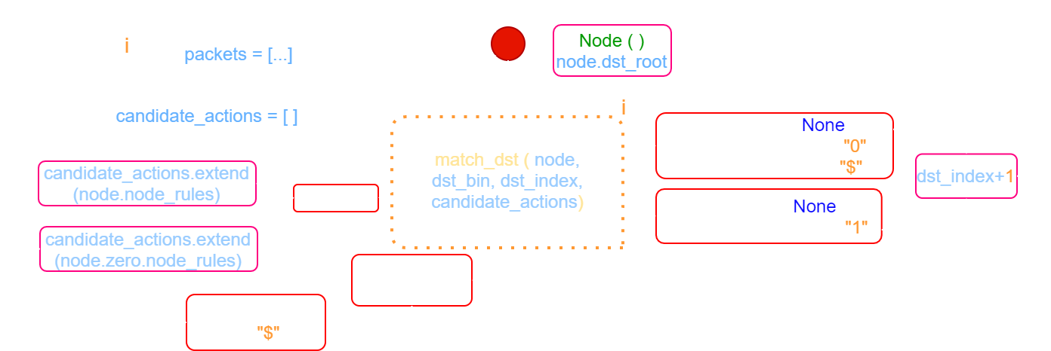
FlowDiagram – match_dst()
def match_dst(node, dst_bin, dst_index, candidate_actions):
if node.end :
candidate_actions.extend(node.node_rules)
if dst_index > 32:
if node.zero.value == "$":
candidate_actions.extend(node.zero.node_rules)
return
if node.zero is not None and (dst_bin[dst_index] == "0" or node.zero.value == "$"):
match_dst(node.zero, dst_bin, dst_index+1, candidate_actions)
if node.one is not None and dst_bin[dst_index] == "1":
match_dst(node.one, dst_bin, dst_index+1, candidate_actions)
return

Slide 18
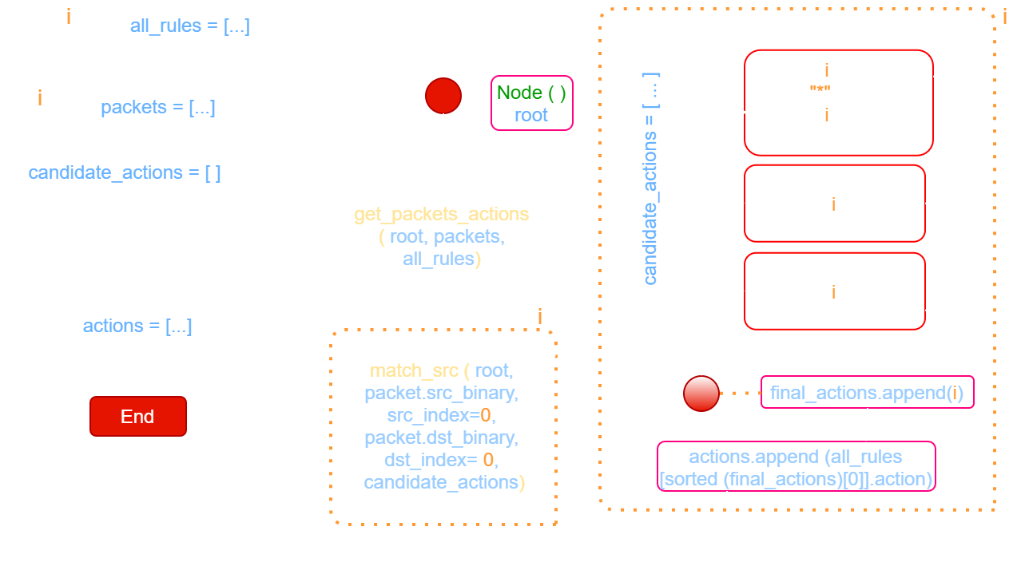
FlowDiagram – get_packets_actions
def get_packets_actions(root, packets, all_rules, debug):
actions=[]
for packet in packets:
candidate_actions = []
match_src(root, packet.src_binary, 0, packet.dst_binary, 0, candidate_actions)
final_actions = []
for i in candidate_actions:
if all_rules[i].protocol != '*' and all_rules[i].protocol != packet.protocol:
continue
if not nu.is_in_port_range(all_rules[i].src_port, packet.src_port):
continue
if not nu.is_in_port_range(all_rules[i].dst_port, packet.dst_port):
continue
final_actions.append(i)
actions.append(all_rules[sorted(final_actions)[0]].action)
return actions

Slide 19
Test Results
Test was performed each time with 100.000 packets and 100 Rules. Since the packets were generated randomly and was only 100 matches per each test, backtracking didn’t happen there, and the average times were very close to each other and the median average time for each packet was 4678 ns.
The same test was performed each time with 100.000 packets but this time with adding 6 more rules which the last 5 rules include “*” in one of their fields and the last rule with using all “*” as a default DENY classification rule in the list. This addition increased the time of classification significantly. The median average time for each packet was 133880 ns, which is 26 times more than the other test.

Slide 20
Performance Evaluation – Time
Search Speed (Classification time):
The total classification increases linearly with the incoming packets
Storage requirement (memory):
evaluation was not successful since the outcome measurements were inaccurate.
Scalability:
Size: classified 1 Million entries in 14425 ms
Header fields: this program doesn’t accept dynamic dimension of classifiers.
Update time:
This program doesn’t consider updates of rules in its algorithm.
Flexibility in specification:
This program accepts NetID and ranges for port numbers.
Using different NetID increased the classification time. Using port ranges instead of numbers did not increased the classification time significantly.

Slide 21
End
Questions?

